Slide 1
Apache Spark
Sameer mahajan

Slide 2
History
2009 research project in UC Berkeley
Learnt from Hadoop
Cluster computing
Multi pass over data
API based on functional programming that could succinctly express multi-step application
in-memory data sharing across computation steps
Version 1: Batch Processing only, Version 2: Interactive
Shark: SQL queries, 2011
AMPlab contributed Spark to Apache and started Databricks
Apache Spark 1.0 in 2014 (Spark SQL API) and 2.0 in 2016
Structured Streaming, 2017

Slide 3
Key Benefits
Parallelism on a cluster
Most actively developed open source engine
Wide support for programming languages (Python, Java, Scala, R)
Unified analytics compute engine for loading, querying, streaming, ML
Consistent, composable APIs
Runs from a laptop to a cluster of thousands of servers
Works with s3, Hadoop, Cassandra, Kafka etc.
Large number of internal and external (http://spark-packages.org) libraries

Slide 4
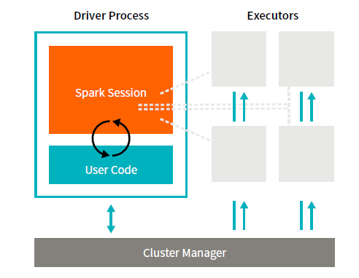
High level architecture

Slide 5
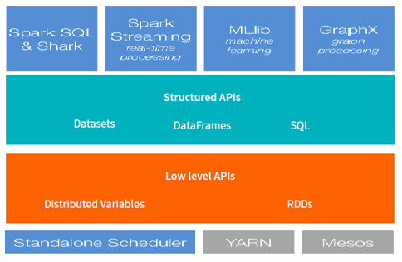
High level view

Slide 6
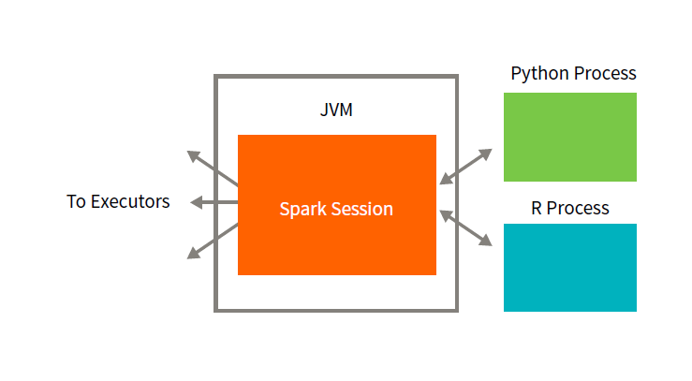
Language support

Slide 7
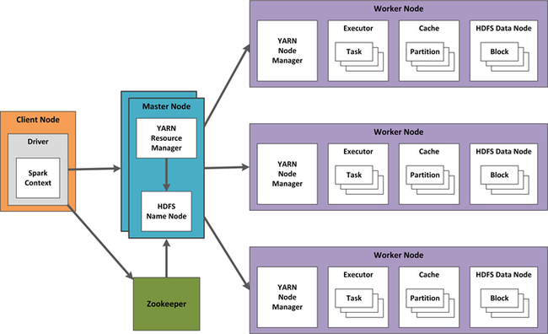
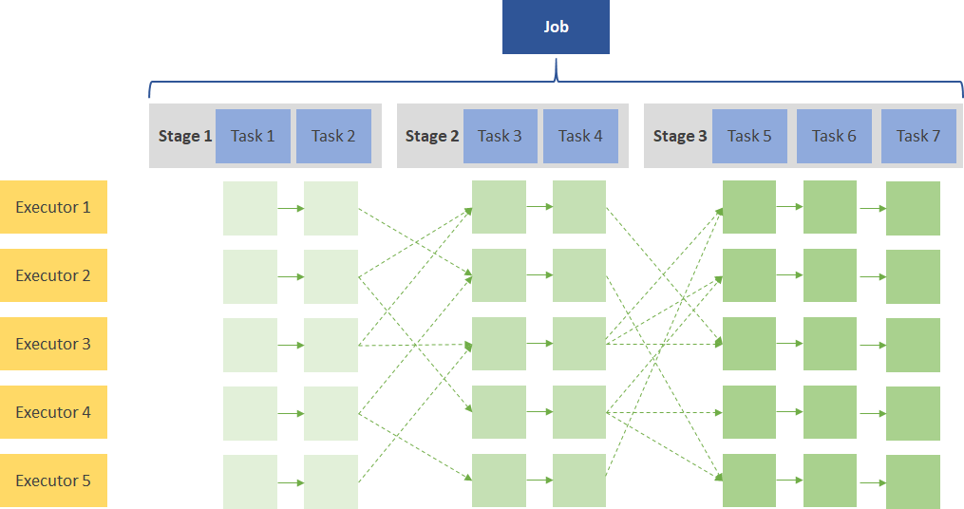
Some Basic Concepts
Partitions
Transformations
Lazy evaluation
Action: triggers the comp
DAG Execution Plan
Master, Worker
Job, Stage, Task

Slide 8
Getting started
Operate at spark dataframe level as much as possible
Spark application is controlled through a driver process
Driver process manifests as spark session
One to one mapping between instance of spark session and spark application

Slide 9
Basics
spark.read to read csv
spark.createDataFrame
define schema, specify values
.repartition(1).write.csv(‘location’) : write spark DF to a single file

Slide 10
Some conversions
.rdd to conver to rdd (.rdd.map (lambda row: row[0]) to convert a column to rdd)
rdd.toDF() : to convert rdd to spark DF
toPandas() : convert spark DF to pandas DF
SQLContext(sc). createDataFrame(pandas_df) : convert pandas DF to spark DF
df.createOrReplaceTempView(‘sql_table’) : convert spark DF into sql table

Slide 11
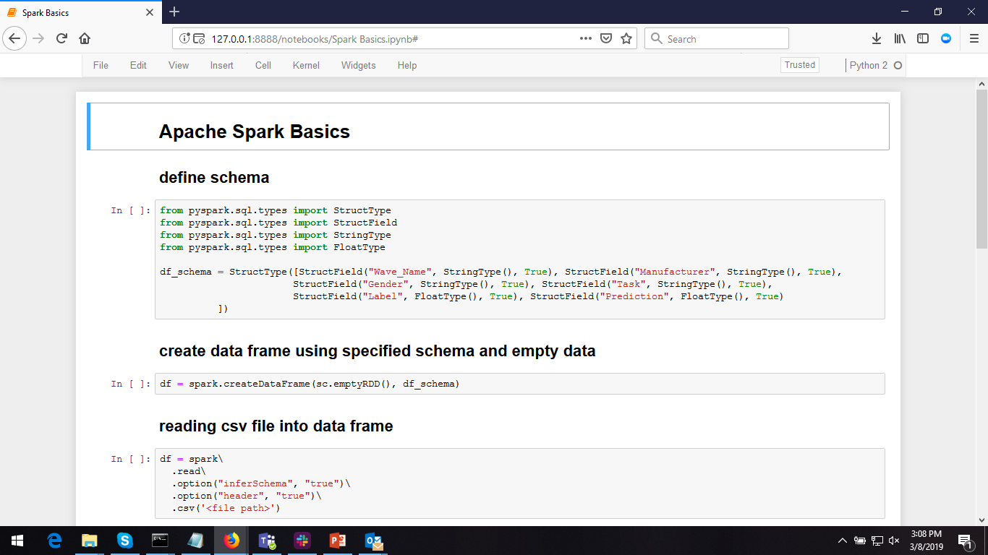


Slide 12
Machine learning libraries
ml
newer implementation
still under development with some experimental classes
works on spark Dataframe
watch out for ‘Experimental’
mllib
older implementation
works on RDD

Slide 13
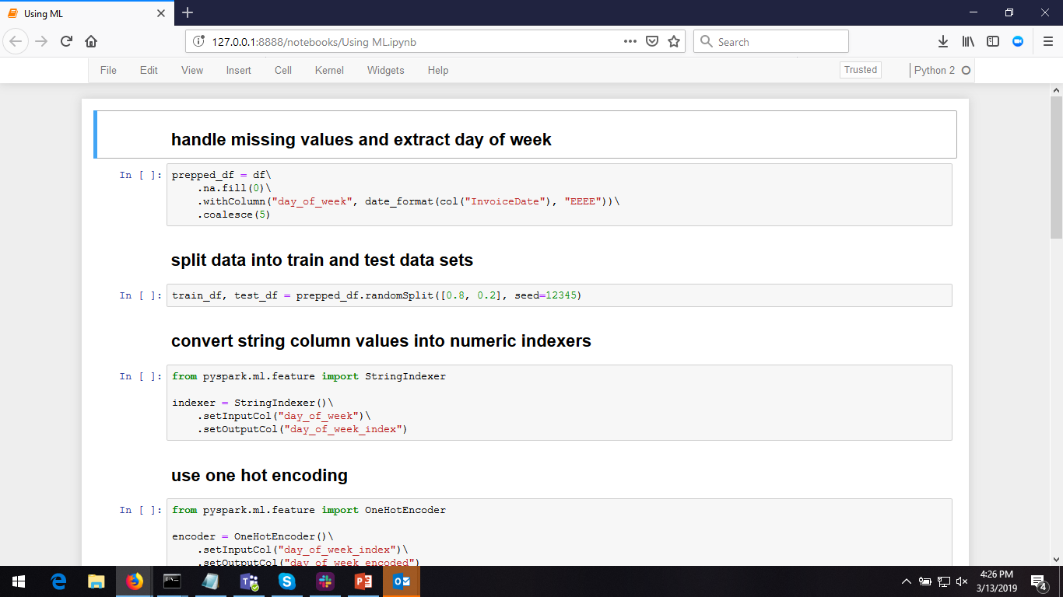

Slide 14
Parallel execution
spark manages splitting into and aggregating results from individual tasks distributed on workers
sc.parallelize and map lambda
parallel task runs on a worker (not driver) node
limitations on what can be passed to and used inside the parallel task
python threads

Slide 15
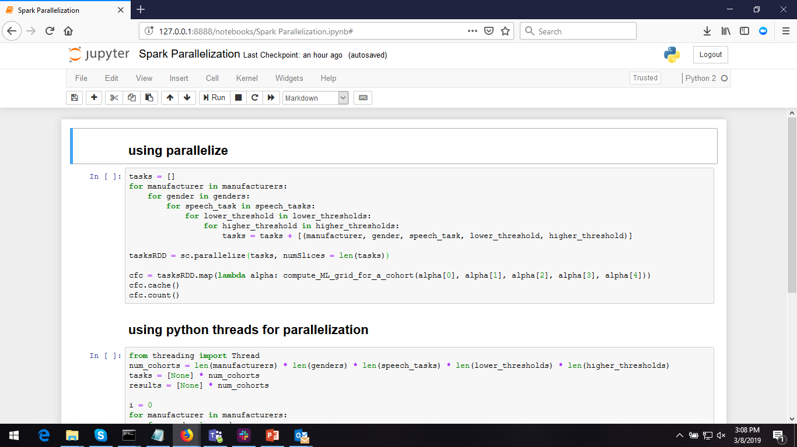

Slide 16
References
http://spark.apache.org/
https://pages.databricks.com/gentle-intro-spark.html
http://shop.oreilly.com/product/0636920034957.do
Spark Python API Documentation: https://spark.apache.org/docs/latest/api/python/index.html

